Slide 1
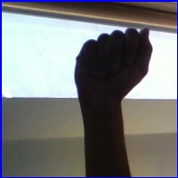
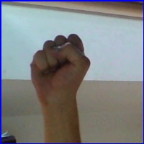
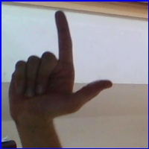
American Sign Language (ASL)
A
S
L
Anjali Mudgal

Slide 2
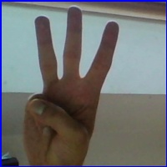
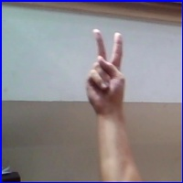
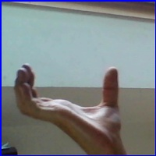
Dataset
Image Dataset 224 X 224 for 1 image
Target Slides
29 classes
A-Z classes
Del
Space
Nothing
W
K
Space

Slide 3
Preprocessing
Resize the data
Convert to gray scale
Normalize the images
Use encoder to reduce the dimensions of data

Slide 4
PCA - Limitations
it assumes that the data is linearly separable, which means that there is a linear relationship between the features
Images often have a spatial structure, where pixels that are close to each other are more likely to be correlated than pixels that are far apart. PCA does not take this spatial structure into account, which can limit its effectiveness in capturing the most important features of an image.

Slide 5

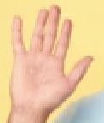
Challenges in Encoder Decoder
Very small dataset (100 images)
Was not training with small number of neurons.
Training was taking a lot of time
Generated output were a mix of target signs.
https://www.kaggle.com/datasets/nikhilgawai/sign-language-dataset

Slide 6
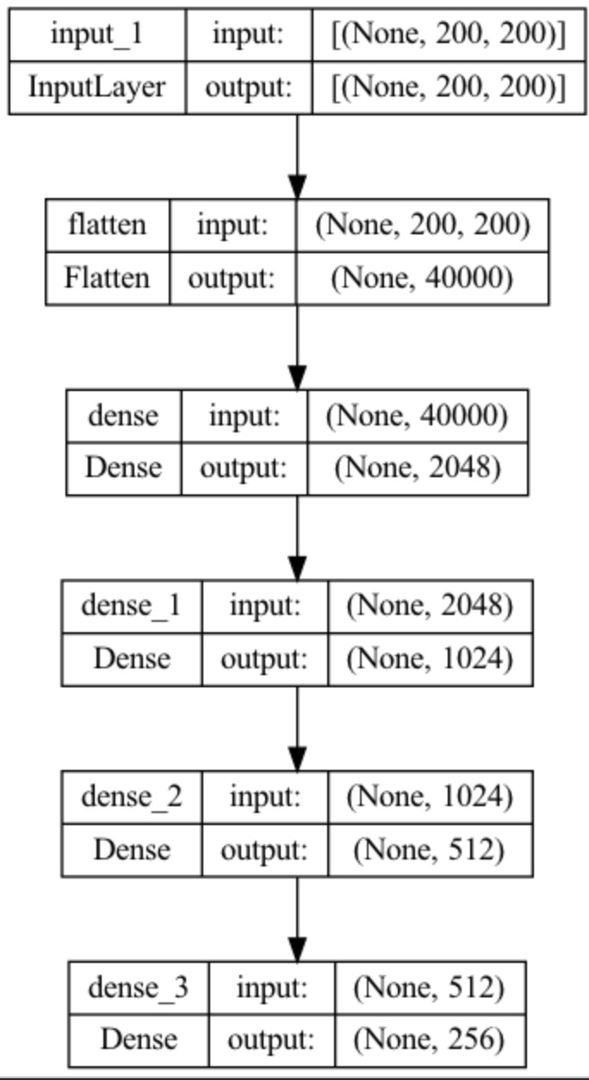
Encoder Decoder – Initial
For dimensionality reduction
224 * 224 = 50176 for 1 image
Generate original image from the dataset
Bottle neck layer will capture the reduced dimensions which will contain the required information

Slide 7
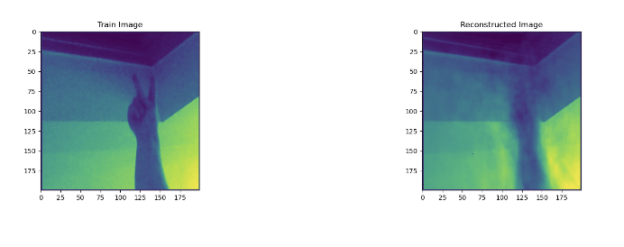
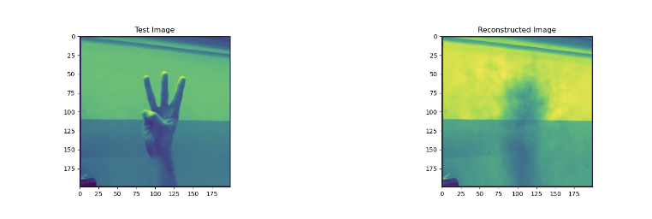
Problems in Image Reconstruction
Because of lighting issues, the decoder was learning only the background and not the foreground
Dataset was huge, couldn’t train such model, so reduced the number of images

Slide 8
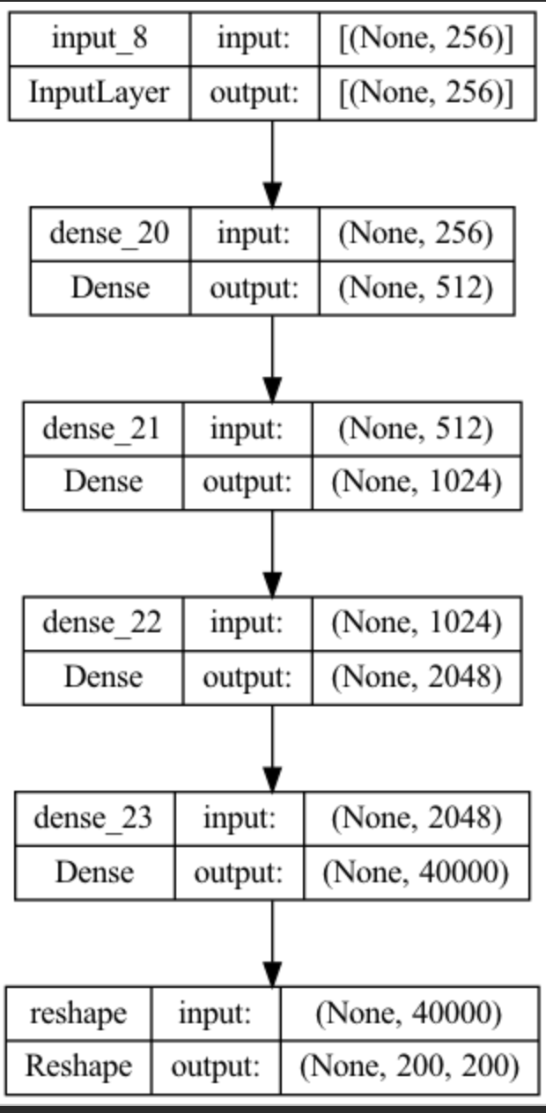
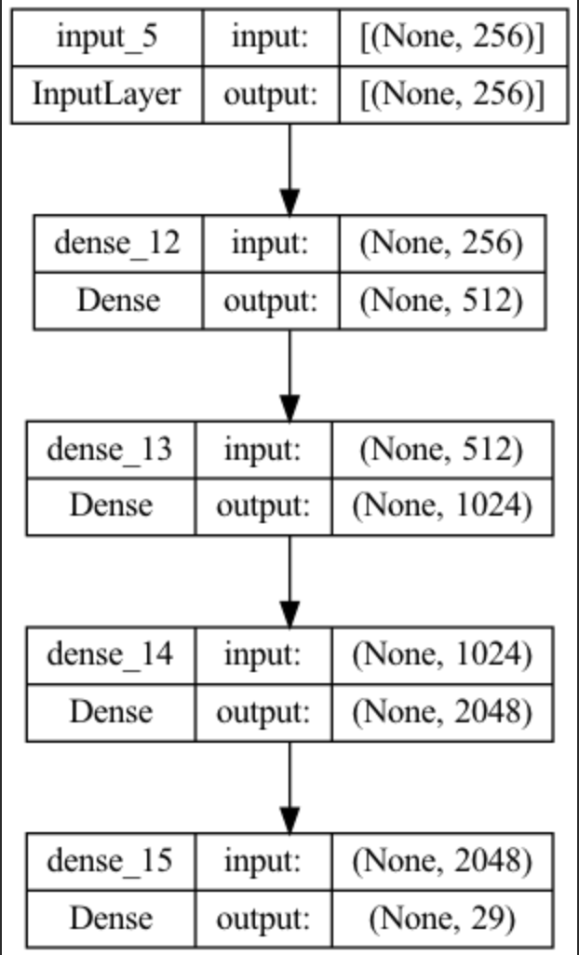
Switching the Decoder
Less number of neurons required
Loss function changed to categorical cross entropy instead of MSE.
Activation changed to softmax

Slide 9
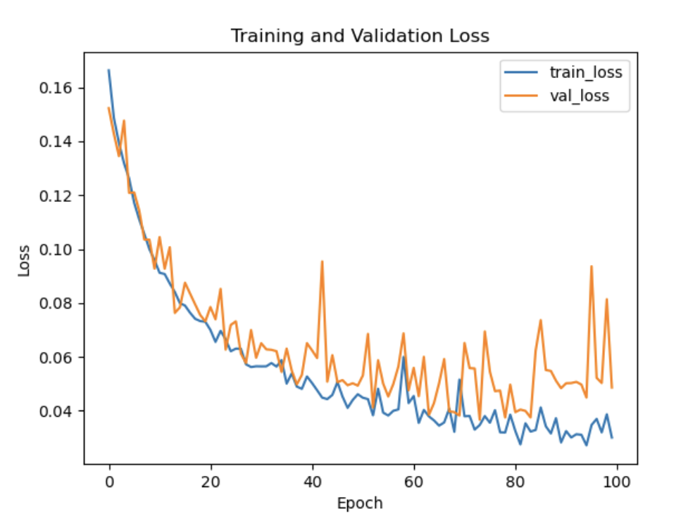
Encoder Decoder
Using less number of epochs
Less data

Slide 10
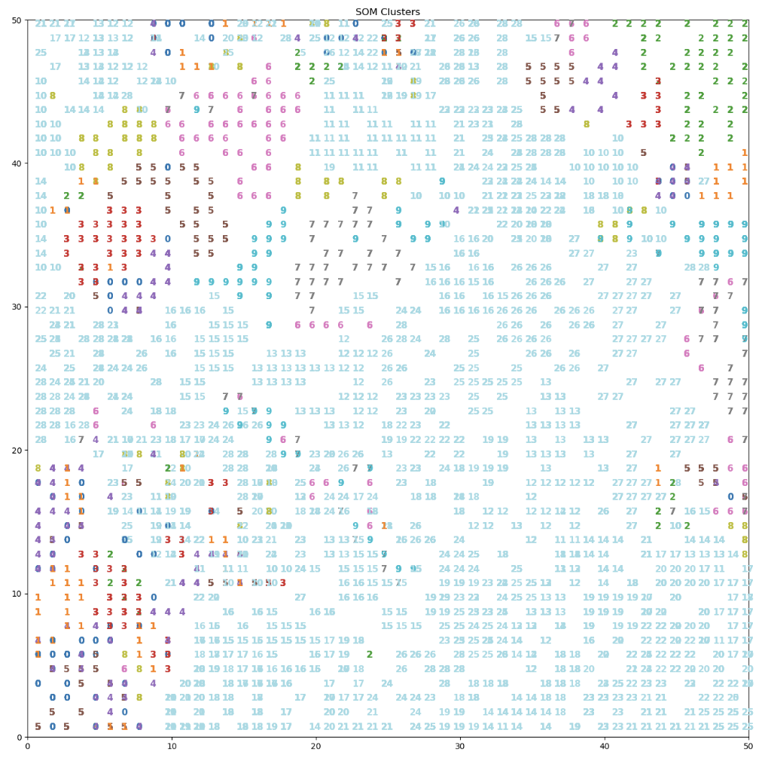
Further Processing
Using predicted image from encoder
Passing the reduced dimensions to SOM

Slide 11
SOM
Initialize the weights of SOM
For each datapoint find the winner neuron by calculating distance
Get the learning rate based on iteration
Update winning neuron weights and neighbouring neurons weights based on gaussian or Mexican hat function
Plot in 2d and 3d

Slide 12
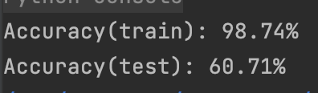
SVM

Slide 13
Thank You

